Slide 1
Smart
Traffic Light
System
Jonathan Lin
Khondakar Mujtaba

Slide 2
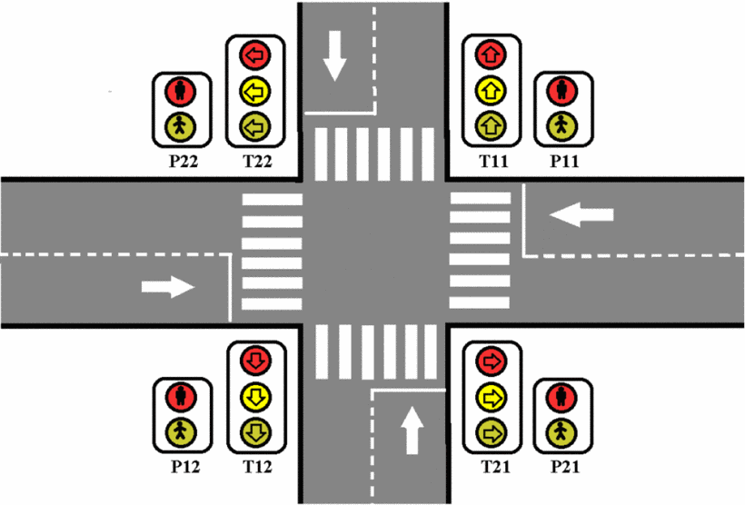
Background

Slide 3
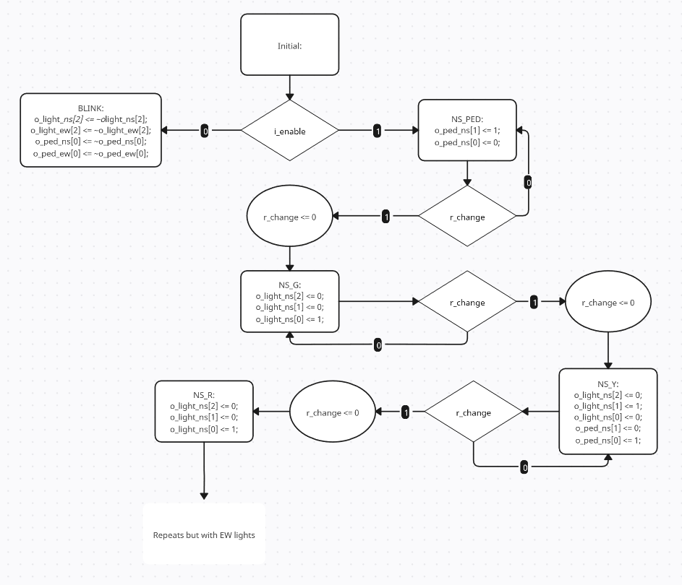
Design

Slide 4

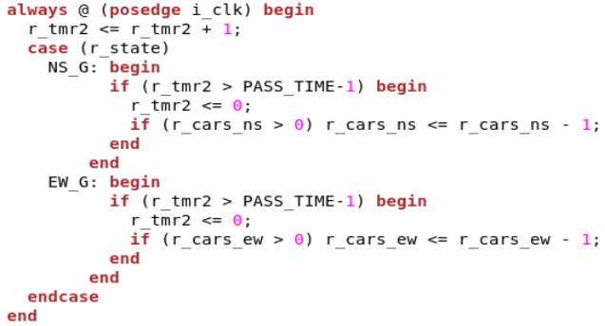
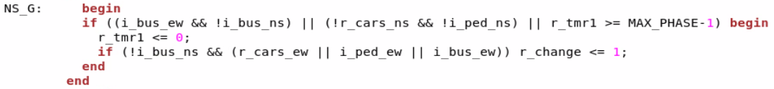
Flexible Phases

Slide 5
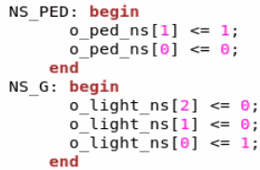
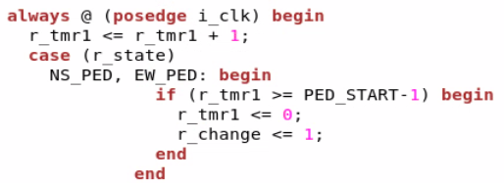
Leading Pedestrian Interval

Slide 6
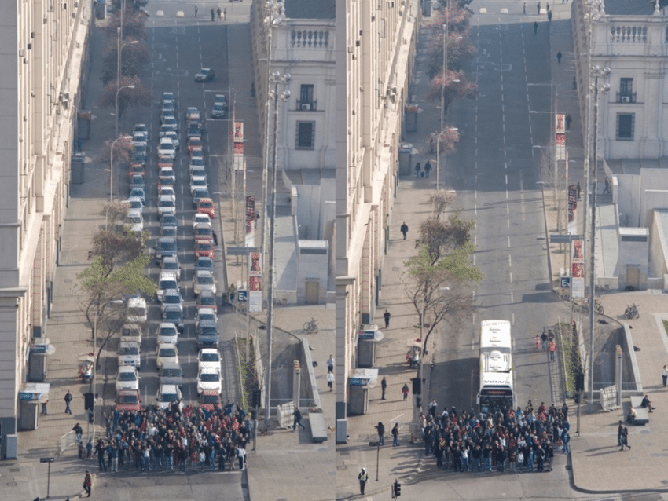
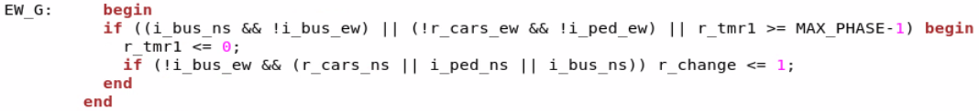
Transit Priority

Slide 7
General Structure
1 always block for managing signal lights
1 always block for managing car counter
1 always block for managing state machine
Had another always block for pipelined implementation
States:
localparam BLINK = 4'd0;
localparam NS_PED = 4'd1;
localparam NS_G = 4'd2;
localparam NS_Y = 4'd3;
localparam NS_R = 4'd4;
localparam EW_PED = 4'd5;
localparam EW_G = 4'd6;
localparam EW_Y = 4'd7;
localparam EW_R = 4'd8;

Slide 8
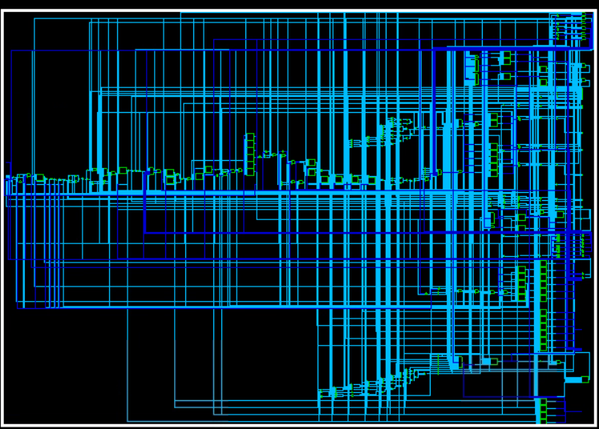
Parallel Implementation
Number of ports: 745
Number of nets: 1742
Number of cells: 995
Number of combinational cells: 802
Number of sequential cells: 101
Number of macros/black boxes: 0
Number of buf/inv: 148
Number of references: 25
Total cell area: 0.000000
Total area: 419.011685

Slide 9
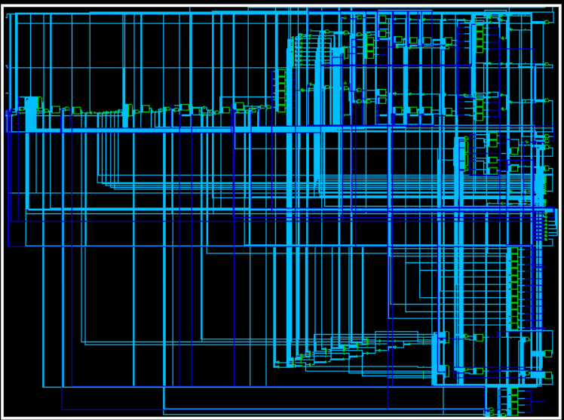
Pipelined Implementation
Number of ports: 558
Number of nets: 1297
Number of cells: 794
Number of combinational cells: 632
Number of sequential cells: 105
Number of macros/black boxes: 0
Number of buf/inv: 93
Number of references: 24
Total cell area: 0.000000
Total area: 385.390071

Slide 10
Comparison (Area and Power)
Pipelined implementation takes up much less area compared to the parallel Implementation
Pipelined Implementation also takes up less power
Pipelined power consumption: 2.5244 uW
Parallel power consumption: 2.7596 uW

Slide 11
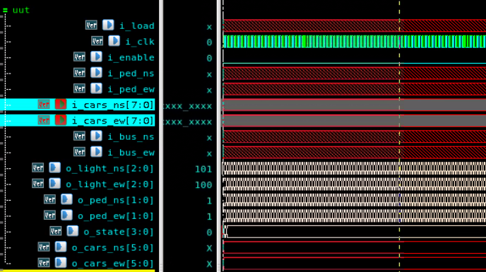
Simulation results (Testing Blink)

Slide 12
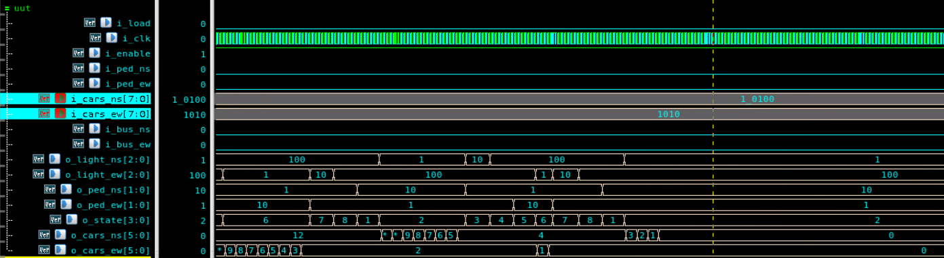
Simulation results (Normal Operation)

Slide 13
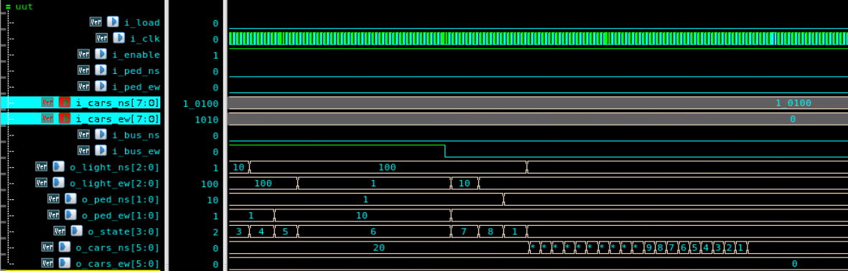
Simulation (Bus Priority)

Slide 14
~Fin

Slide 15
Works Cited
Ortúzar, Juan de Dios. “Sustainable Urban Mobility: What Can Be Done to Achieve It?” Journal of the Indian Institute of Science, vol. 99, no. 4, 28 Nov. 2019, pp. 683–693, https://doi.org/10.1007/s41745-019-00130-y.
“Pedestrian Head Starts | Portland.gov.” Www.portland.gov, www.portland.gov/transportation/traffic-operations/pedestrian-head-starts.
Pinder, Matt. “Signals for Change: Ideas from the Dutch for Improving Traffic Lights.” Beyond the Automobile, 11 Aug. 2020, beyondtheautomobile.com/2020/08/11/signals-for-change/.
Zhilevski, Marin, et al. Design of a Traffic Light System Using Verilog HDL. 8 June 2023, pp. 1–6, https://doi.org/10.1109/hora58378.2023.10156804. Accessed 24 Mar. 2025.

